Slide 1

COMMUNICATION
HOW TO GIVE INSTRUCTIONS

Slide 2

Communication is simply the act of transferring information from one place, person or group to another.
Every communication involves (at least) one sender, a message and a recipient. This may sound simple, but communication is actually a very complex subject.
The transmission of the message from sender to recipient can be affected by a huge range of things. These include our emotions, the cultural situation, the medium used to communicate, and even our location. The complexity is why good communication skills are considered so desirable by employers around the world: accurate, effective and unambiguous communication is actually extremely hard.

Slide 3

There are basically two types of communication: Verbal communication and non-verbal communication. Verbal communication consists of words used to communicate messages whereas non-verbal communication is gestures that give out messages. Today we speak about how to give instructions in English!

Slide 4

HOW TO GIVE INSTRUCTIONS TO EMPLOYEES
Instructing your employees clearly will help you get desired results that your organization is looking for. The instructions may be given verbally or via electronic mail. Bosses will need to have sharp communication skills to delegate work to their sub-ordinates.

Slide 5

MAIN POSITIONS
Grab attention
Give clear instructions
Show respect
Have two-way communication
Be Simple
Keep track

Slide 6
HOW TO GIVE THE DAILY
INSTRUCTIONS IN ENGLISH
USE SEQUENCERS AND THEN THE ACTIONS:
First(ly)...
Then...
Next...
After that...
Finally...
THE BEST SANDWICH IN THE WORLD.
First, you must roast a chicken and slice it into thick pieces.
Then toast your favourite bread (two slices).
After that you need to put mayonnaise and mustard on the toast and then the chicken slices.
Next you are going to add your vegetables. Tomatoes, lettuce onions, cucumbers etc.
Finally put a couple slices of cheese on the sandwich and then close it with the other piece of toast.

Slide 7
HOW TO MAKE A CUP OF COFFEE
First you need to buy some coffee and a coffee maker.
Then you have to put the water into the bottom of the coffee maker.
You needn't boil the water (you don't need to boil the water), cold water is fine.
Next you have to put the coffee in the coffee compartment and screw the top of coffee maker on.
After that you need to put the coffee pot onto the stove.
Then turn the stove on hight and wait. You don't have to move the coffee pot.
When the water boils and goes into the upper part of the pot youthen have to remove the pot from the heat.
Finally you pour some coffee into a cup, add sugar and milk and enjoy.

Slide 8

We use the imperative form to give orders or directions in English.
“Eat your vegetables!”
“Turn left and go straight on.”
We can also use the imperative form to give a warning or advice, and (if you use “please”) to make a request.
“Practise English for ten minutes a day!”
“Be careful!”
“Please take a seat.”

Slide 9
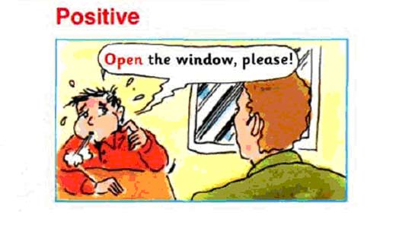
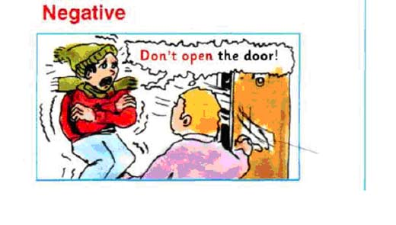
TO MAKE THE IMPERATIVE, USE THE INFINITIVE OF THE VERB WITHOUT ‘TO’:
“Come here!”
“Sit down!”
TO MAKE A NEGATIVE IMPERATIVE, PUT “DO NOT” OR “DON’T” BEFORE THE VERB
(DON’T IS MORE INFORMAL THAN “DO NOT”):
“Don’t go!”
“Do not walk on the grass.”

Slide 10

HOW TO REPLACE A LIGHT BULB
Firstly, turn off the electricity.
Secondly, remove the light bulb.
Then, screw in the new light bulb.
Finally, turn the electricity on and switch on the light.

Slide 11
WHEN YOU GIVE INSTRUCTIONS, YOU CAN HELP THE OTHER PERSON
WITH EXTRA INFORMATION AND ADVICE
Remember: turn off the electricity before touching any cables.
Be careful not to … (touch any live wires)
Try to … (see if the lightbulb is broken or just loose)
Try not to … (touch the lightbulb with your hands)
You need to … (check the wattage of the lightbulb first)
It’s important to … (make sure the electricity is off)
It helps to … (wait for the lightbulb to cool down before you remove it)
Be sure to … (turn off the electricity before you you touch the lightbulb)
Always … (wear gloves when you touch a lightbulb)
Never … (touch a socket with wet hands)

Slide 12
USEFUL VERBS FOR INSTRUCTIONS
Turn on / switch on = activate power or electricity: “First, turn on the PC.”
Turn off / switch off = deactivate power or electricity: “Turn off the lights when you leave.”
Take off / remove = detach something from another thing: “Remove the plastic before you put the meal in the microwave.”
Take out = take one thing out from another thing: “Take the television out of the box.”
Attach / connect = put two things together: “Connect the wires.”
Check / make sure = be sure about something: “Check that the light is on.”
Proceed / continue: “Continue to stir until the mixture is thick.”
Plug in = connect to the electricity: “Plug the modem in.”
Put back / replace: “Replace the cover after changing the battery.”

Slide 13

Choose the correct answer:
1. __ a seat!
Please to take
Take
To take
2. __ down.
Please sit
Please to sit
Sitting
3. __ cry!
Do not to
Don't
Don't to

Slide 14

Choose the correct answer:
4. __ go.
Please don't
Please not to
Please to
5. __ read the question carefully.
It's important
It's important to
It's too important to
6. __ your full address.
Be sure to write
Be sure write
Sure to write

Slide 15

Choose the correct answer:
7. __ the television.
Plug in
Take off
Take out
8. __ the light is on.
Make sure
Switch on
Turn off
9. __ the batteries when they stop working.
Put back
Remove
Turn on
10. __ the printer to the PC.
Connect
Switch off
Turn on

Slide 16


